Slide 1
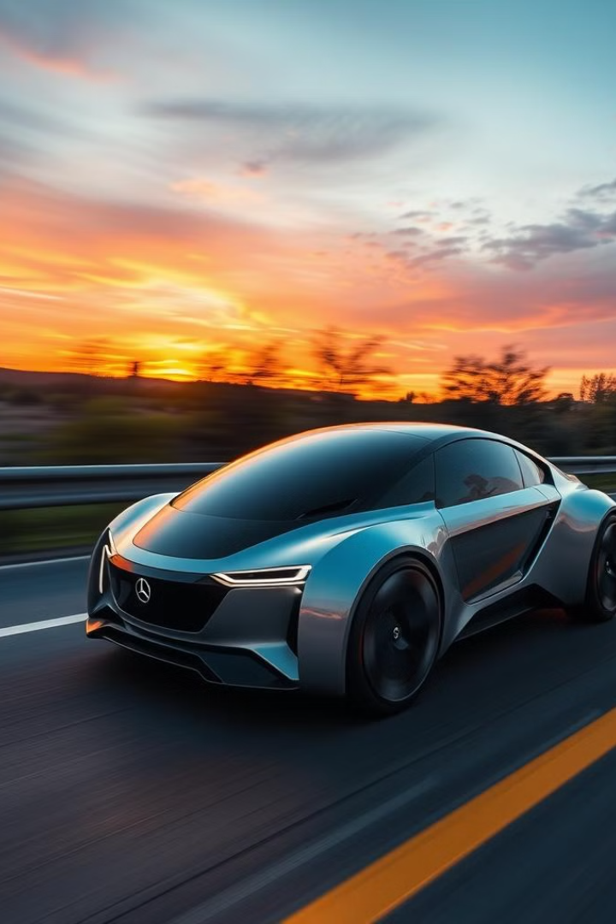
MobiFive: A Smart Car Project
MobiFive is an innovative smart car project. It integrates modern technology to create an autonomous vehicle. It showcases the power of electronics and IoT.

Slide 2

MobiFive Presentation Agenda
1
Project Overview
2
Core Functionality
Introduction to the goals of the MobiFive project
Explanation of the car's autonomous navigation
3
Technical Specifications
4
Impact and Future
List of components and the circuit diagram
Highlights the impact and future enhancements

Slide 3

Project Overview
Team
N. Jeruckshan (Team Leader)
K. Dilakshan
Grade
Grade 9
Location
Vavuniya, Omanthai
School
V/Omanthai C.C.

Slide 4
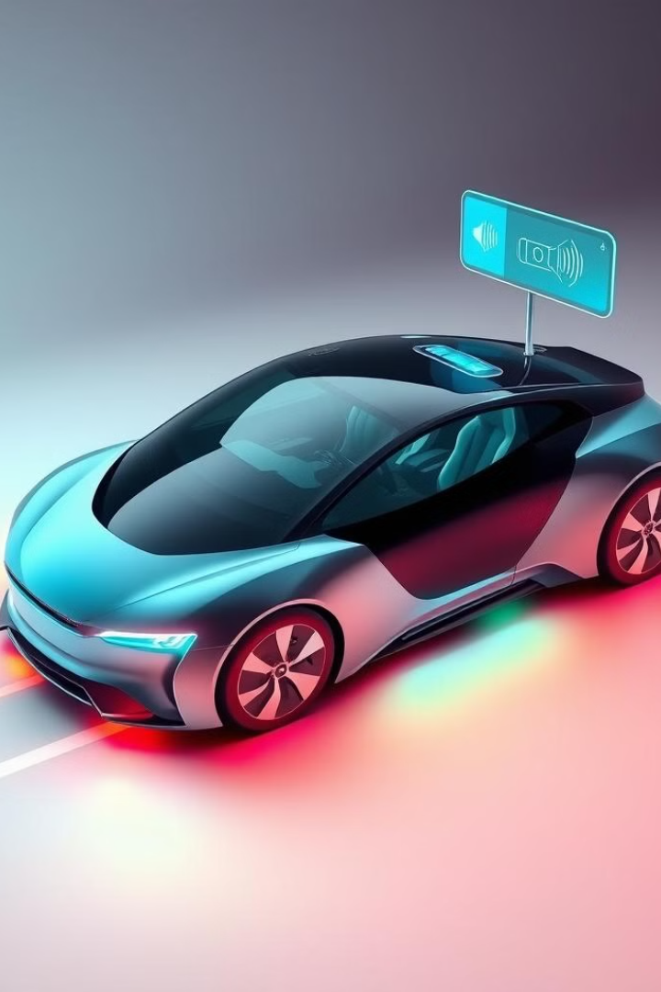





Key Features of MobiFive
Line Following
Object Avoidance
Voice Control
Live Streaming
Virtual Remote Control

Slide 5
MobiFive's Core Components
Power
Sensing
Interface
7.4V Battery
Ultrasonic Sensor
ESP32 Camera
Switch
IR Sensor
HC05 Bluetooth
Breadboard
Control
Body
AMS1117 Voltage Regulator
4 Wheel Smart Car Chassis Kit
L298N Motor Driver
Arduino UNO

Slide 6
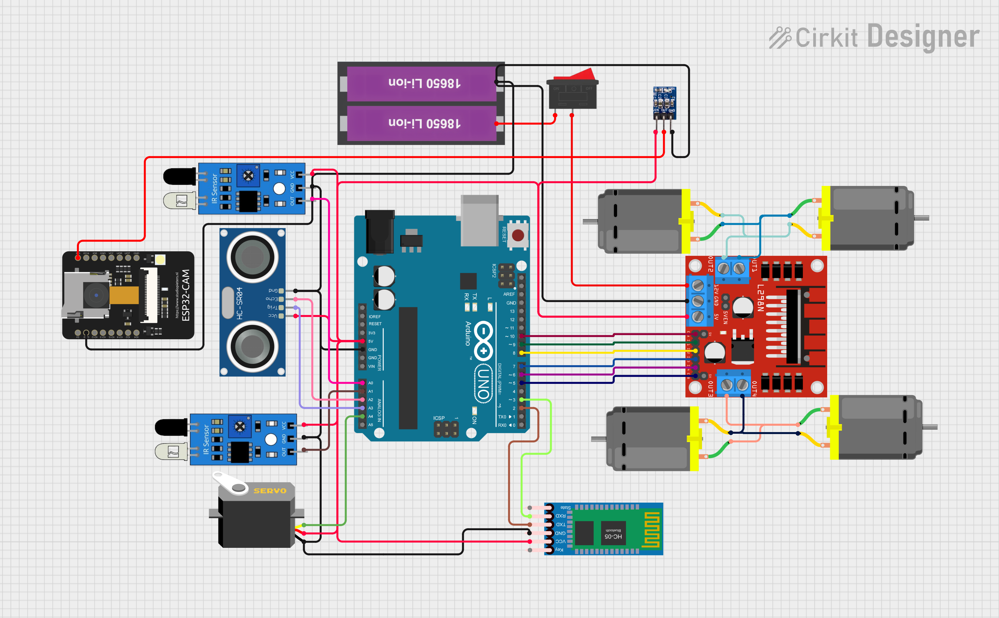

MobiFive Circuit Overview
This diagram illustrates the wiring connections between all components. It highlights the integration of each part to work in unison.

Slide 7
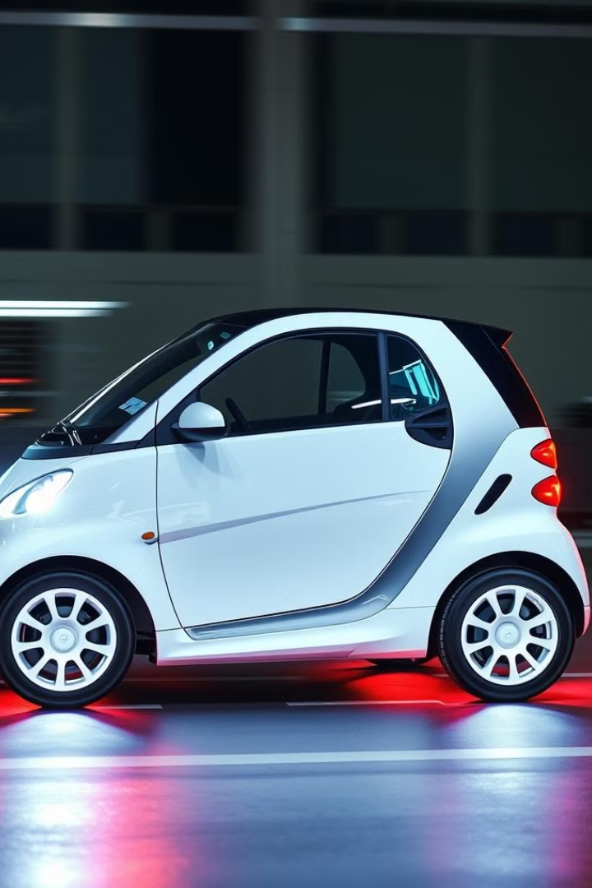





A virtual remote car is a car that you can control using an app on your phone or a remote device, instead of using traditional car keys or controls.
A virtual remote car is a car that you can control using an app on your phone or a remote device, instead of using traditional car keys or controls.
A virtual remote car is a car that you can control using an app on your phone or a remote device, instead of using traditional car keys or controls.
A virtual remote car is a car that you can control using an app on your phone or a remote device, instead of using traditional car keys or controls.
MobiFive Operation
Line Follow
IR sensors detect and follow the line
Object Avoid
Ultrasonic sensors detect obstacles.
Voice Control
Voice commands dictate actions
Live Stream
Remote monitoring through ESP32
Virtual Remote Control
A virtual remote car is a car that you can control using an app on your
phone or a remote device, instead of using traditional car keys or controls.

Slide 8



Impact and Summary
Innovation
1
Presents a functional smart car, showcasing new possibilities in vehicle technology.
Integration
2
Integrates electronics and IoT, demonstrating how these technologies can converge.
Demonstration
3
Demonstrates autonomous vehicle capabilities, providing a tangible example of future transportation.

Slide 9
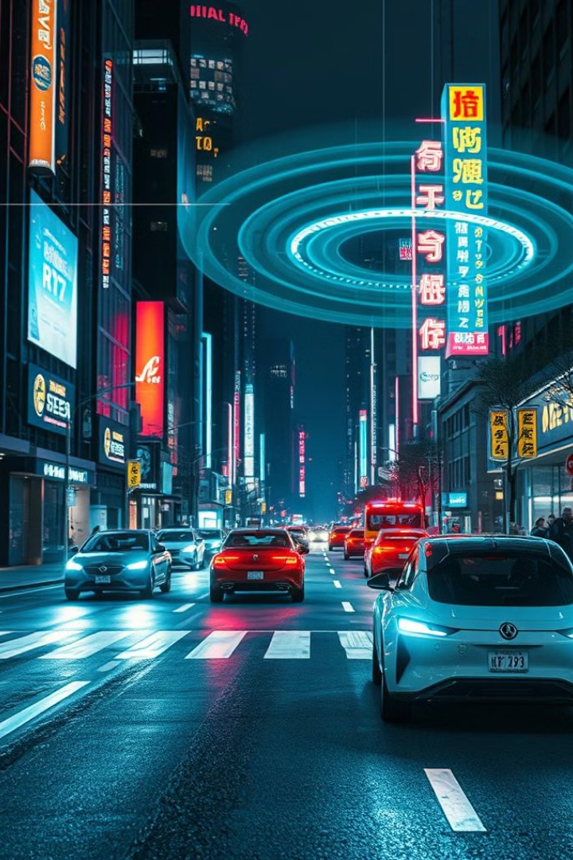



Future Enhancements
GPS Tracking
Improved Object Detection
Advanced AI

Slide 10
Acknowledgements
V/Omanthai C.C
Learning platform and support
Mrs.J Kajaluxshy
Guidance and mentorship

